Slide 1

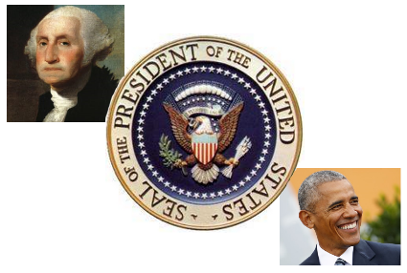
Inaugural Speeches from
1789 to 2009
Analysis and visualization

Slide 2
Abstract
Project Goals;
Explore and understand the Natural Language Tool Kit’s (NLTK) Inaugural speech Corpus.
Visualize the most used words in three ways;
  Through the complete time span (1789-2009)
  Visualize and compare the first and last speech of the corpus.
Conclusion;
There appears to be a similarity in the most words used through the period and between George Washington's first speech and Barrack Obamas first speech.

Slide 3
Motivation
I’ve often listened to and read many of these speeches and find them fascinating. When I discovered NLTK and the fact that it had a corpus of these speeches I couldn’t resist to explore them in this way.

Slide 4
Dataset(s)
The data set used was the Inaugural Speeches NLTK corpus of the same.
This can be found here; http://www.nltk.org/

Slide 5
Data Preparation and Cleaning
No additional data cleaning was required.
The data was well prepared by NLTK.

Slide 6
Research Question(s)
What words are used most across all speeches in the set.
Visualize the words from all sets and from the first and last speeches.

Slide 7
Methods
The data was imported using MLTK and it’s functions used in the initial analysis of the data and in the aggregation of the data to find the most used words.
Matplotlib and WordCloud were used for the visualizations.

Slide 8
Findings / Conclusion
The data is almost complete and well prepared by NLTK. There are two speeches missing, Barack Obama’s second speech and Donald Trumps first.
Using just the visualizations, there is a striking similarity across all speeches and between the first and last in the corpus. A more in-depth analysis would be needed to find nuances and changes.

Slide 9
Acknowledgements
Thanks to NLTK for this data and many other useful, unstructured data samples.
The online documentation for matplotlib and WordCloud was very helpful in complete the visualizations.
The DataCamp course Data Science for R also set the stage for me in their sections on Natural Language and Visualizations even though for a different language.

Slide 10
See Project Jupyter Notebook in the same GitHub repository.

